Slide 1
WASTE
MANGMENT FOR
SMART CITY
Team name
Hack Inversion

Slide 2
Problem Statement
Indore today generates over 1,115 MT of garbage a day and all of it is collected from the source whether it is a household or commercial establishment. Indore has been divided into 19 zones and 85 wards. Each ward has on an average 6,000 households and 600 commercial establishments (part of 88 notified commercial areas). In Indore, waste is generated from various sources including households, commercial areas and other institutions like RWAs, hospitals, hotels among others. To overcome all the deficiencies of present system and to establish solid waste management system of Indore city as per and Solid Waste Management Rules 2016 following actions are required.
100% door to door collection and storage of waste.
To make city bin free so as no storage of waste can be done along roads.
Fixing of litter bins in all commercial areas. Establishment of modern transfer stations at strategic locations

Slide 3
Main Modules
There are three main modules used in the project
Waste segregation
(using Machine learning)
Posting complaint (with location sharing)
Admin
dashboard

Slide 4
Our Proposed solution

Slide 5
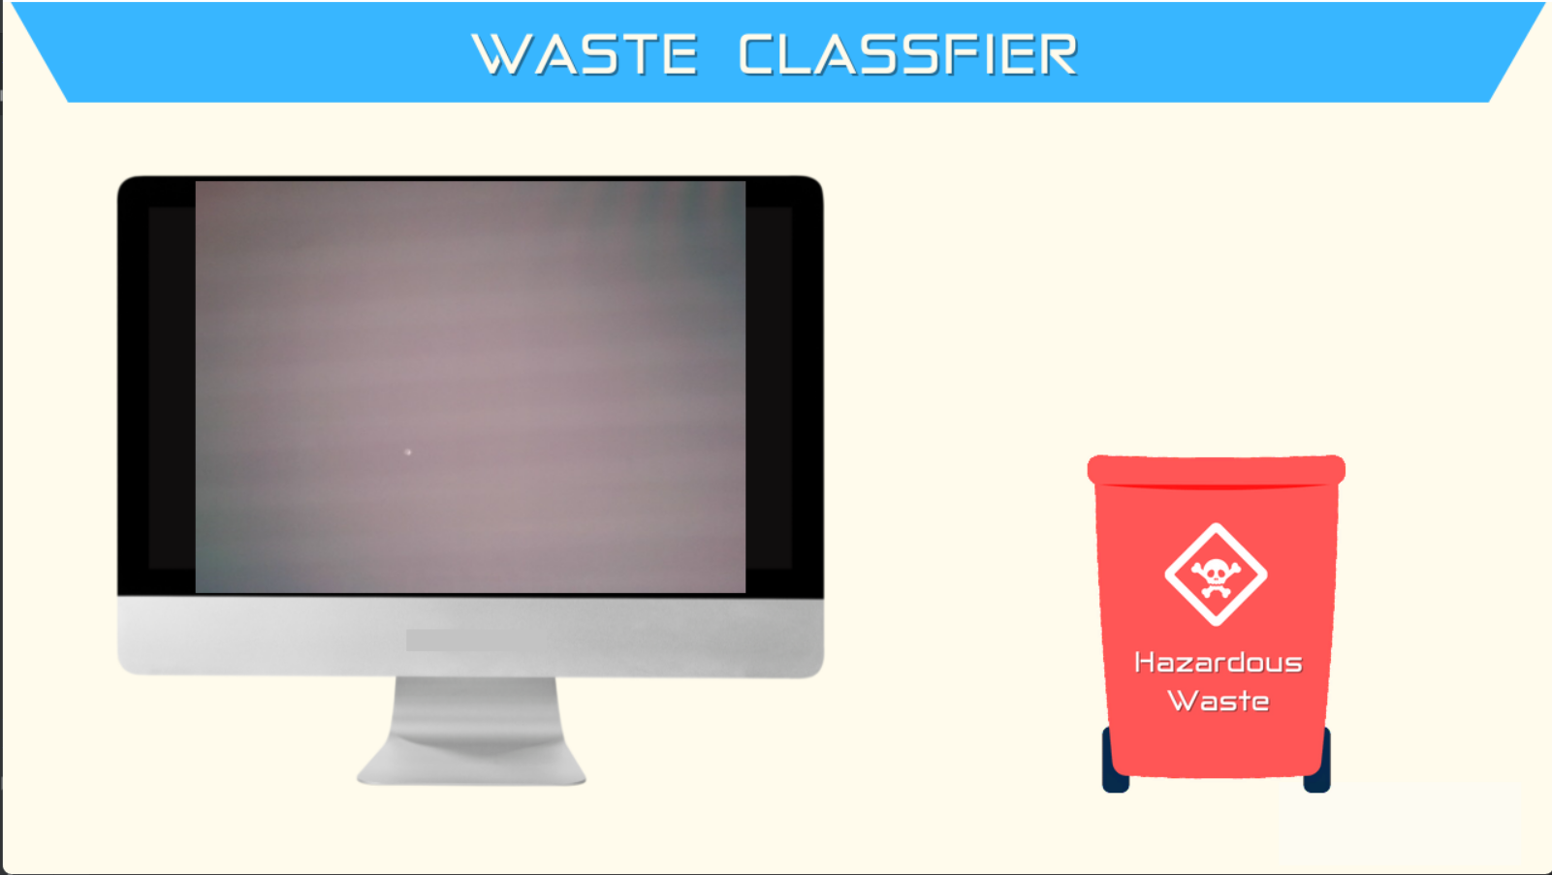
TECNOLOGY USED

Slide 6
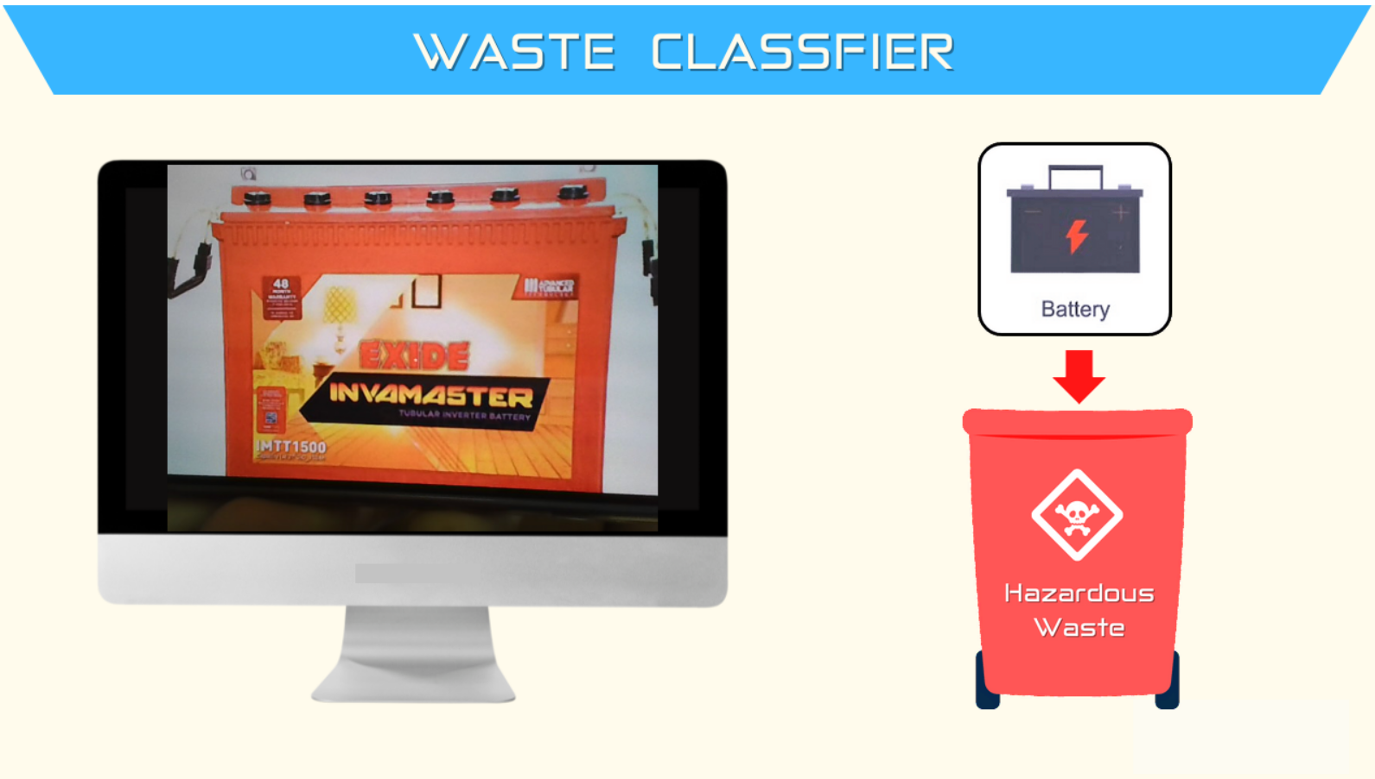
output

Slide 7
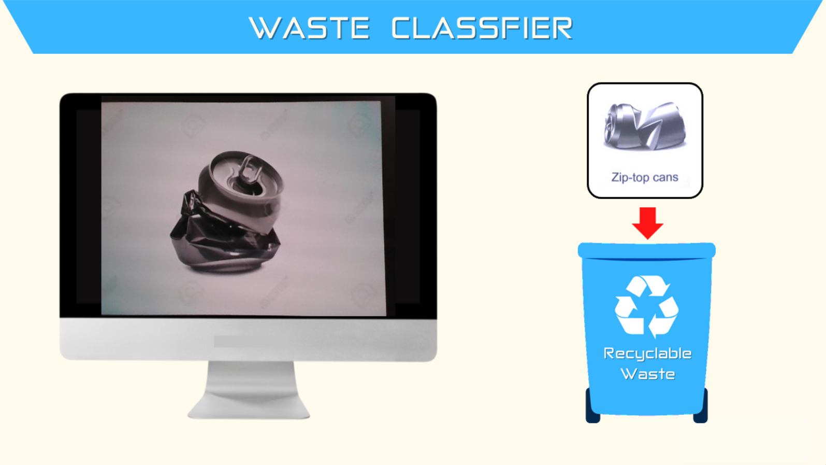
output

Slide 8
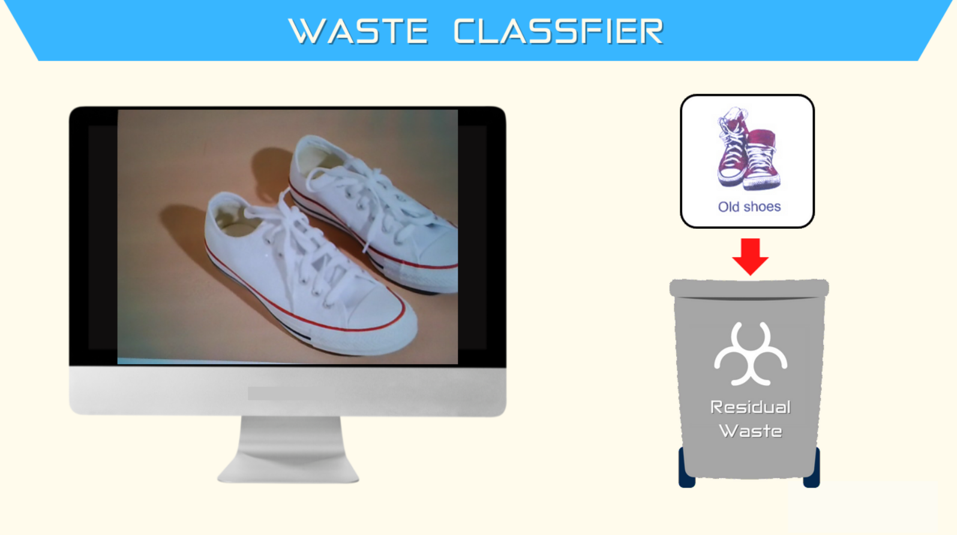
output

Slide 9
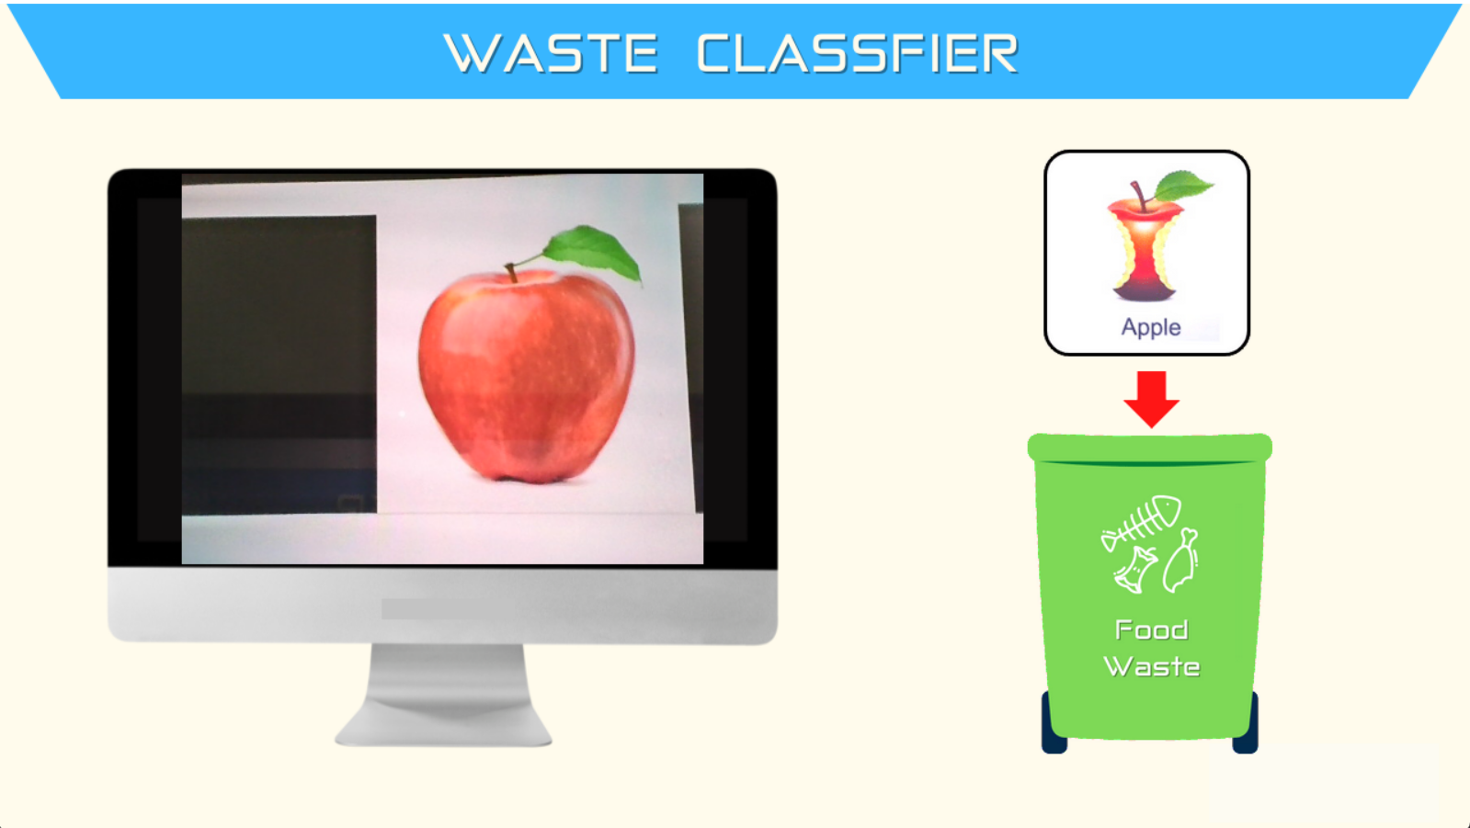
output

Slide 10
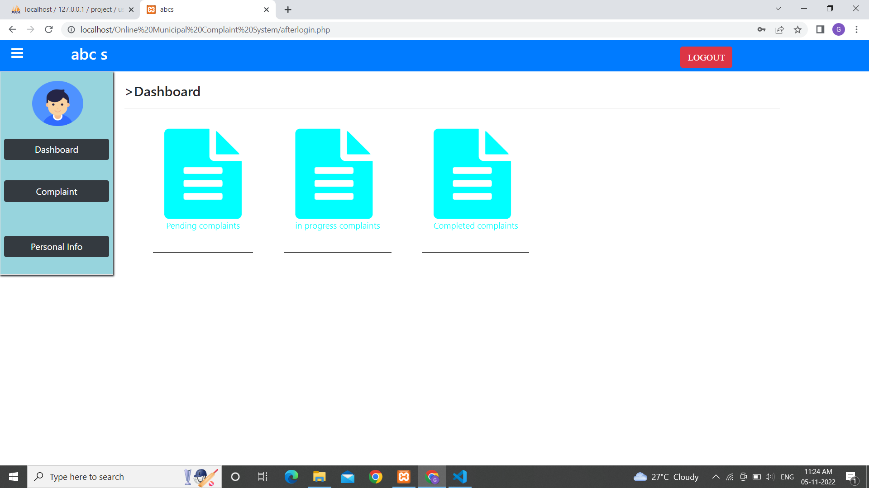
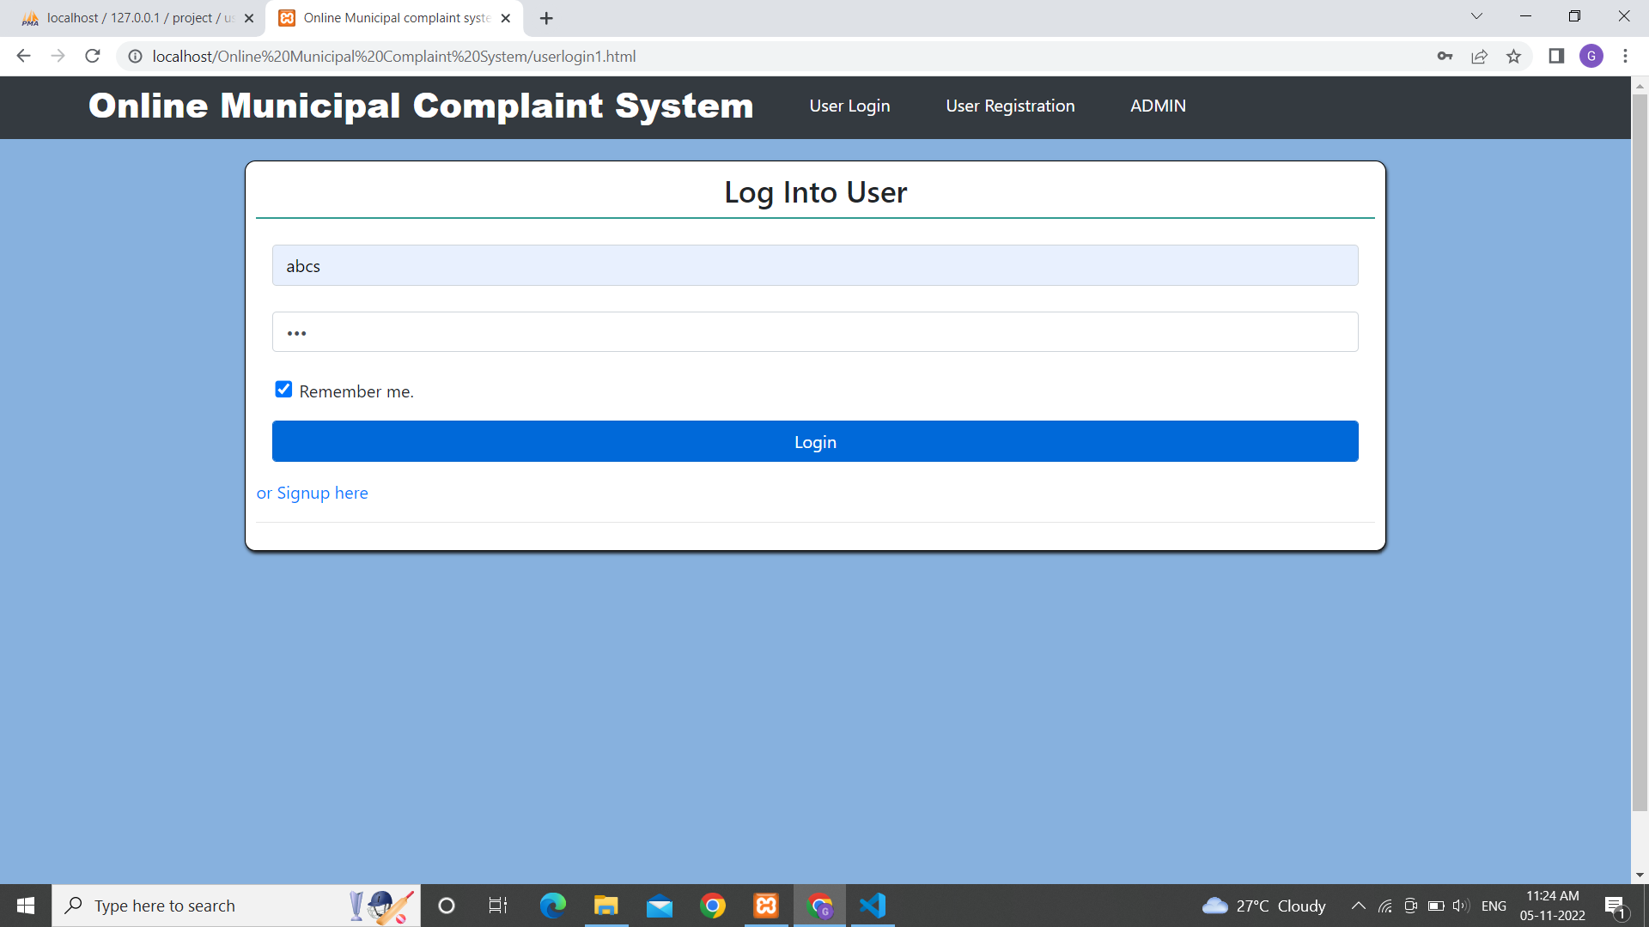
Web complaint output

Slide 11
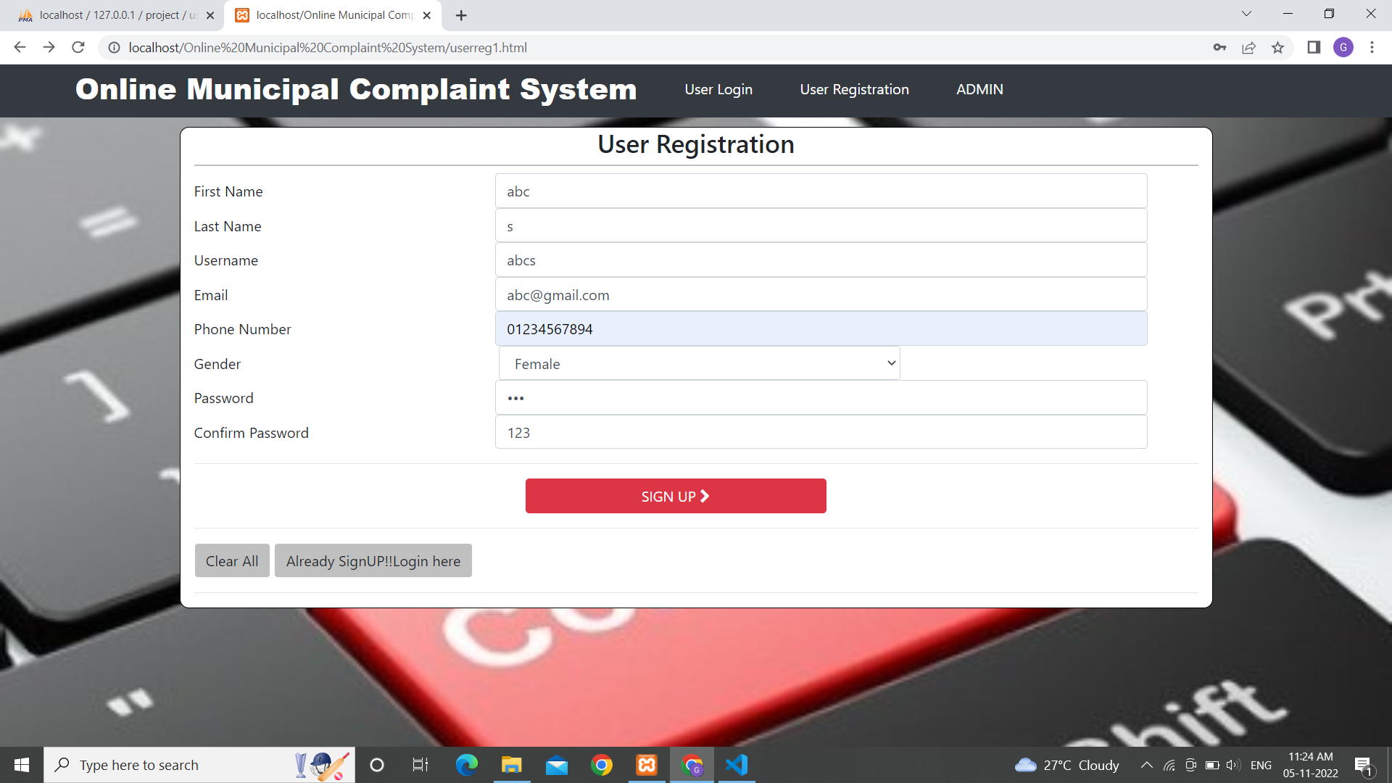
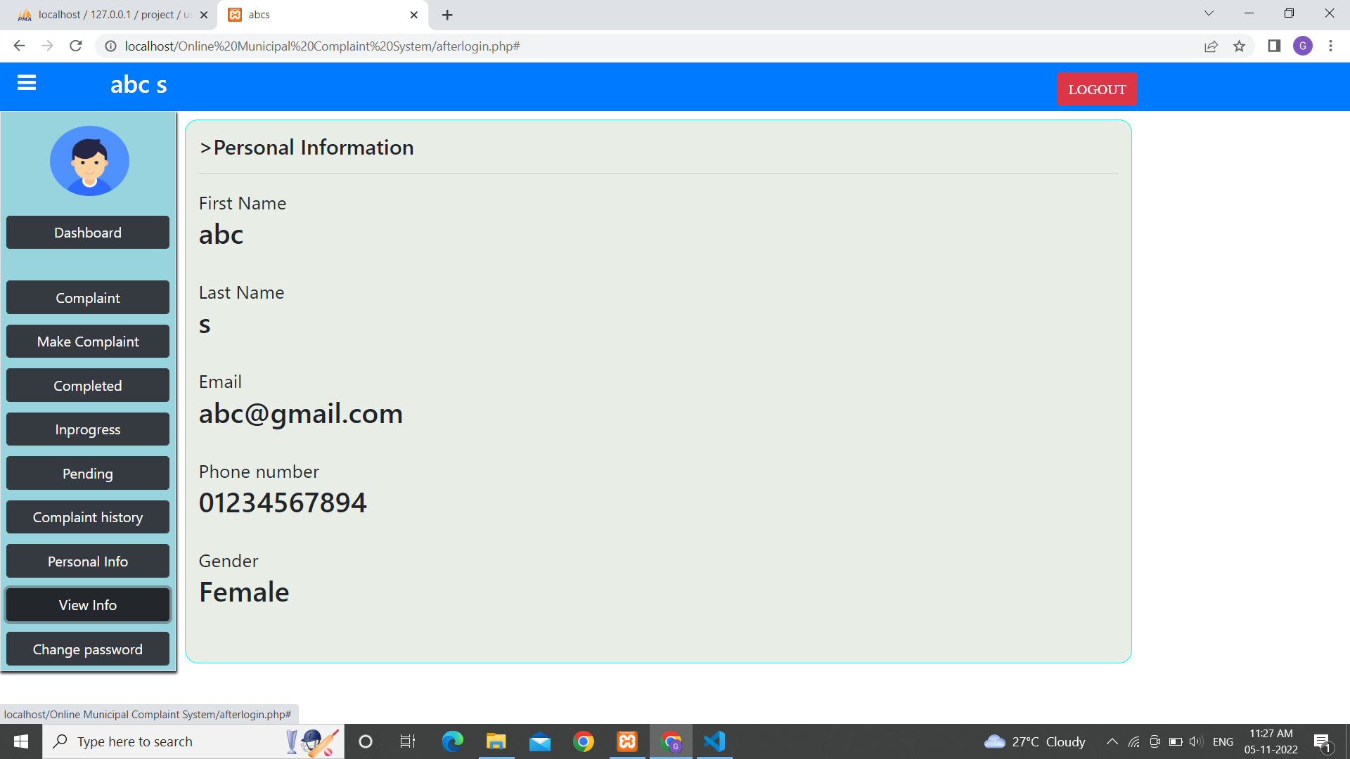
Web complaint output

Slide 12
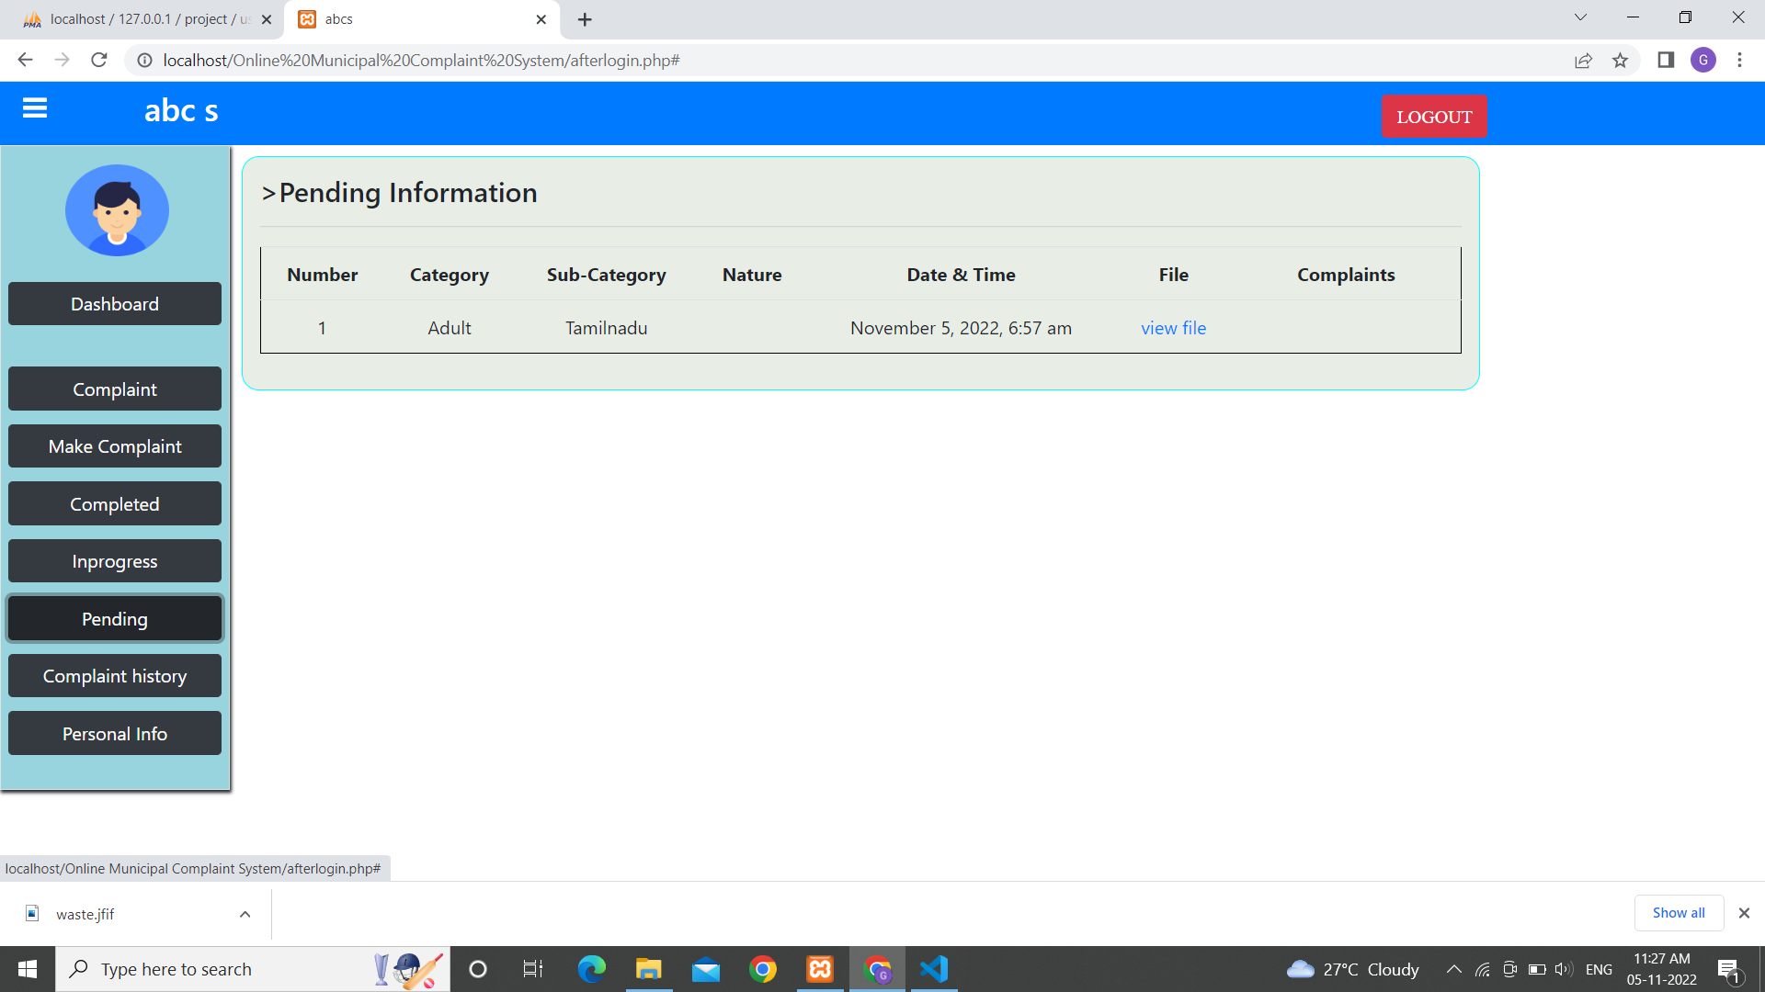
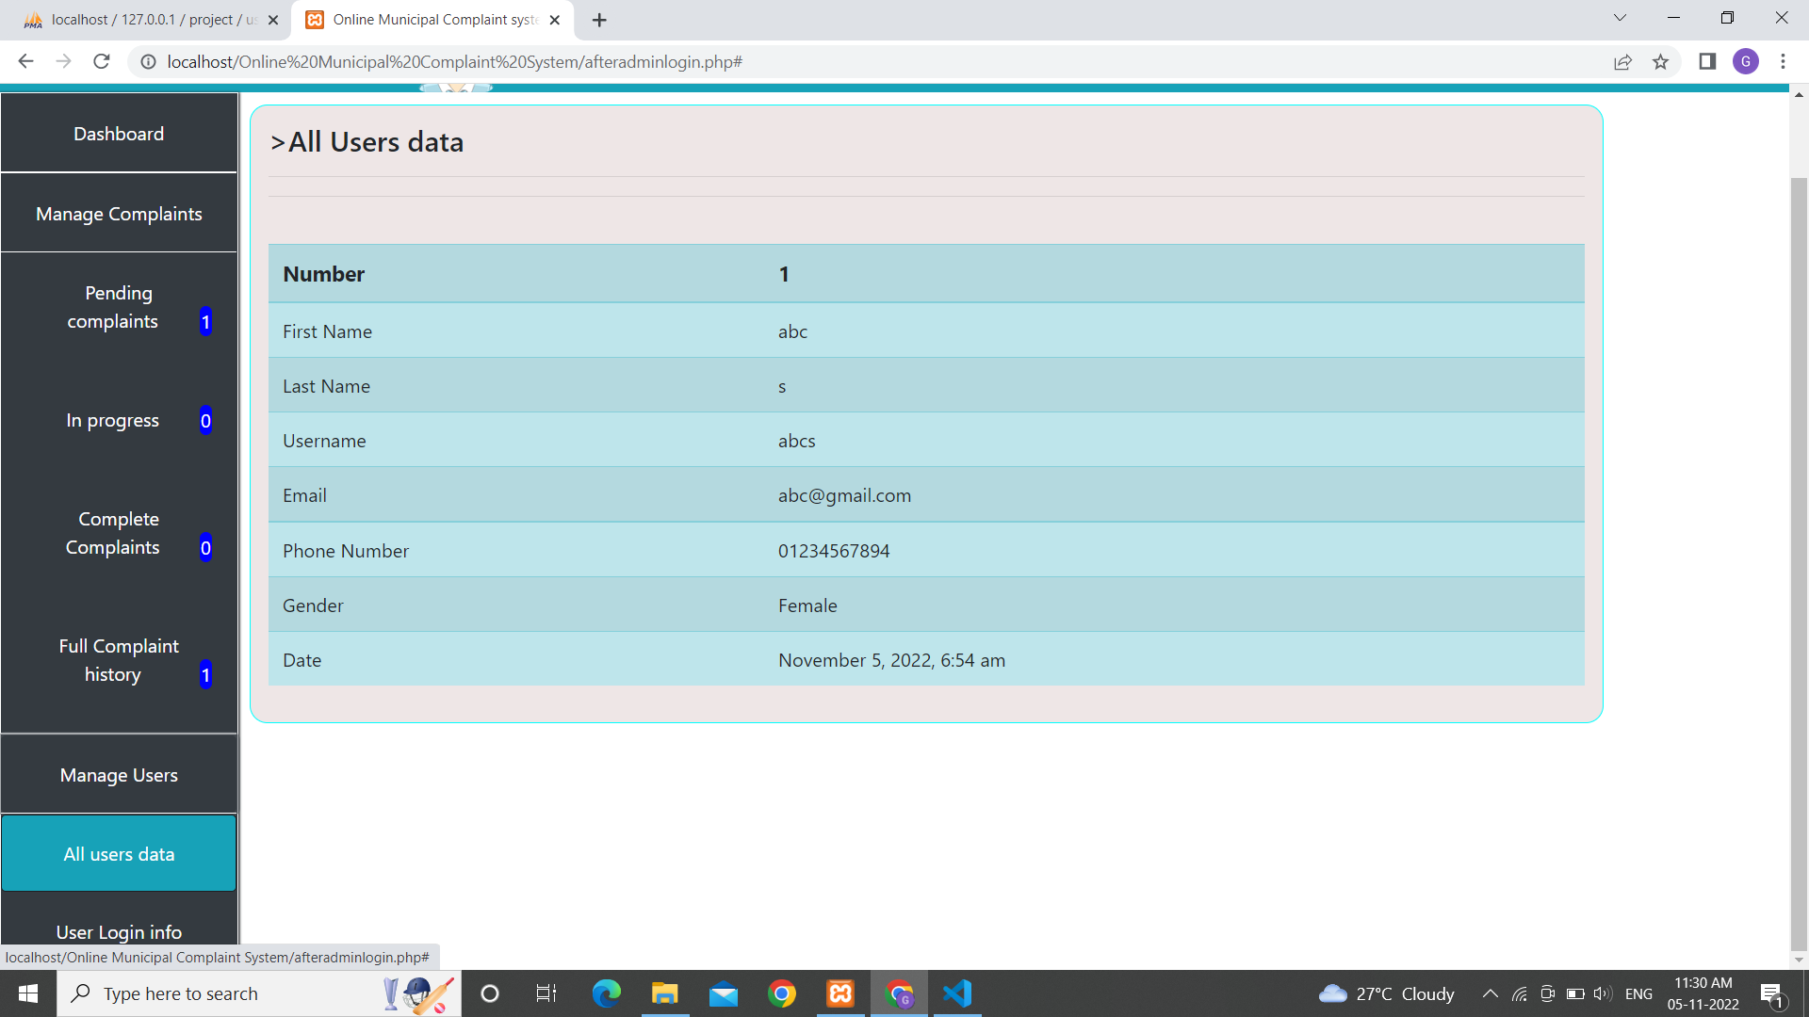
Web complaint output

Slide 13
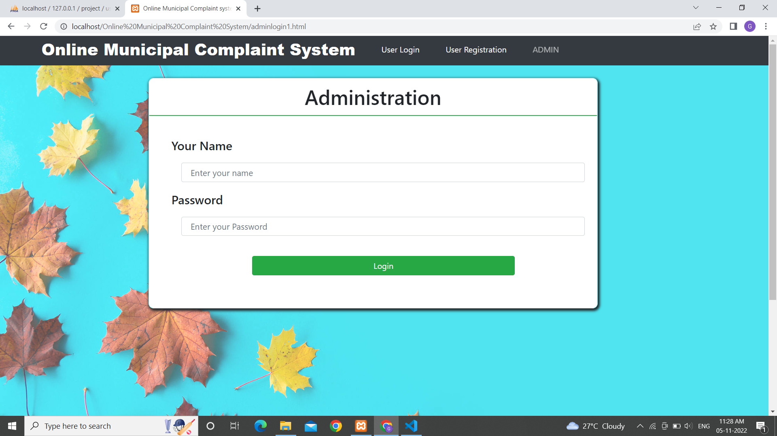
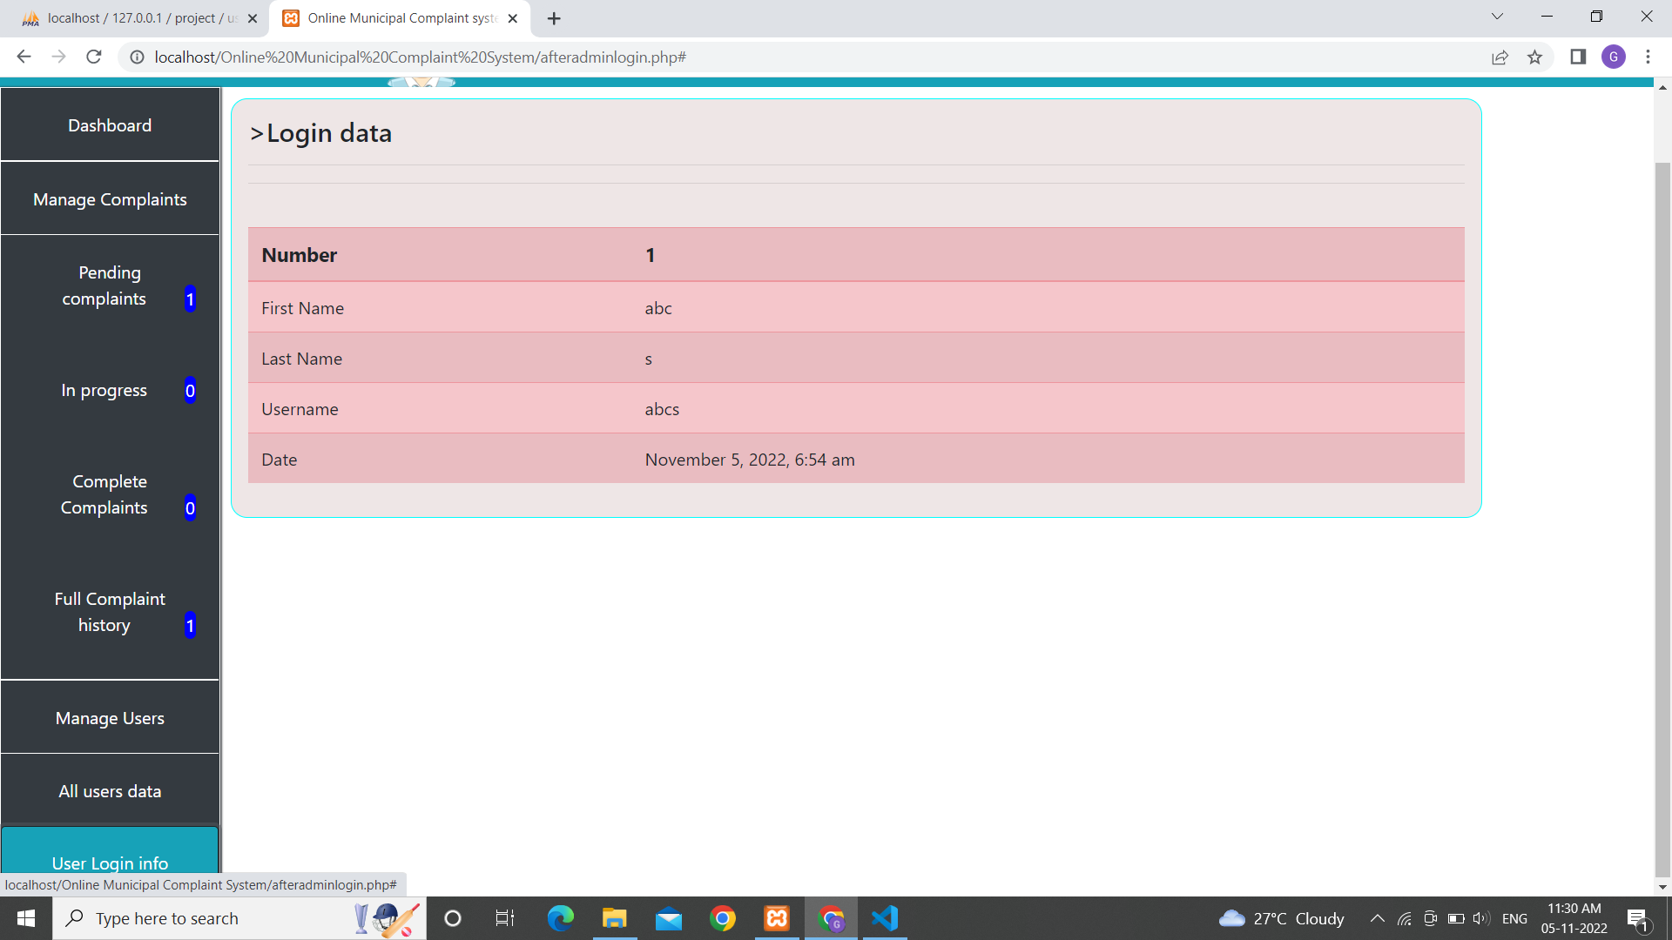
Web complaint output

Slide 14
Conclusion Thus the project for a smart city and waste management is developed successfully.
THANK YOU

